Slide 1
Research Project Workshop 05:
Efficient Searches, Part II
May 3, 2017
Andrew Hamilton, MS, MLS
Laura Zeigen, MA, MLIS, MPH
& Letisha Wyatt, PhD
Instructor(s):

Slide 2
learning outcomes
1 Recall: How to frame your question (define
concepts and keywords) and the
benefits/application of controlled vocabulary
2 Understand and apply unique features of
Ovid Medline database interface (“adjacency”
searching)
3 Understand and apply the unique features of
Scopus database searching
(journal publishing information; author and
institution searching)

Slide 3


comprehensive searches
specificity
sensitivity
Notes:
WHEN AM I DONE??
we want comprehension but not at the sake of thousands of articles to search through

Slide 4
5 A’s method of searching
Assess
Apply
Ask
Appraise
Acquire
Copyright © Centre for Health Evidence

Slide 5
next steps
Building a search (keywords vs. MeSH)
Evaluate your results!
Search details box
MeSH terms on good articles
Revise as needed and try again
Saving your fish: references doc for citation management software
Saving your net: PubMed MyNCBI to save and automate search
Notes:
Build = one term at a time

Slide 6
asking/refining your question
Concept mapping
PICO
These help:
Define broad topical concepts
Describe relationships between concepts
Organize ideas
Develop keywords
Notes:
Difference between background and foreground question
Concept maps = good for developing background (more mechanistic) questions
PICO = good for developing more clinical (applied) questions **don’t start with a question and pull out pieces for PICO!

Slide 7
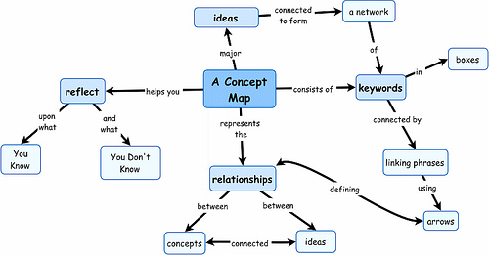
overview of concept maps
Image from here
Notes:
Try making a concept map!
Letisha’s demo
valentine’s day candy example

Slide 8
overview of PICO
P = Population or patient
I = Intervention or exposure
C = Comparison*
O = Outcome
T = Time factors*
S = Setting*
*may not always have this piece

Slide 9
PubMed MeSH terms
Medical Subject Headings:
terms tagged to an article when being indexing in PubMed
Controlled vocabulary!
Updated annually
MeSH terms database – essentially a thesaurus
Tree structure
Hierarchies and exploding
Subheadings

Slide 10
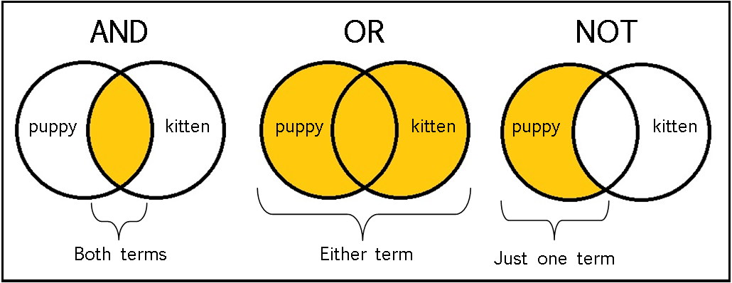
boolean operators
Adapted from https://sites.google.com/a/onalaskaschools.com/tech/boolean-search-tools
Notes:
Provided example: HIV and AIDS; HIV or AIDS

Slide 11
scopus!

Slide 12
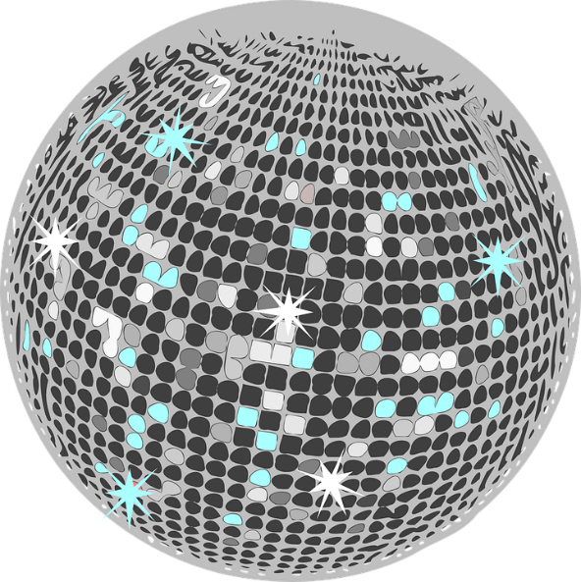
The Magic of Scopus!
Laura Zeigen, MA, MLIS, MPH, AHIP
May 3, 2017

Slide 13
Overview
What is Scopus?
Title and topic searches and basic navigation
“Cited by” sort
Using Scopus to figure out which journals might be useful to publish in
Author search
Institution/affiliation search
Other stuff (saving lists, exporting)
Syntax

Slide 14

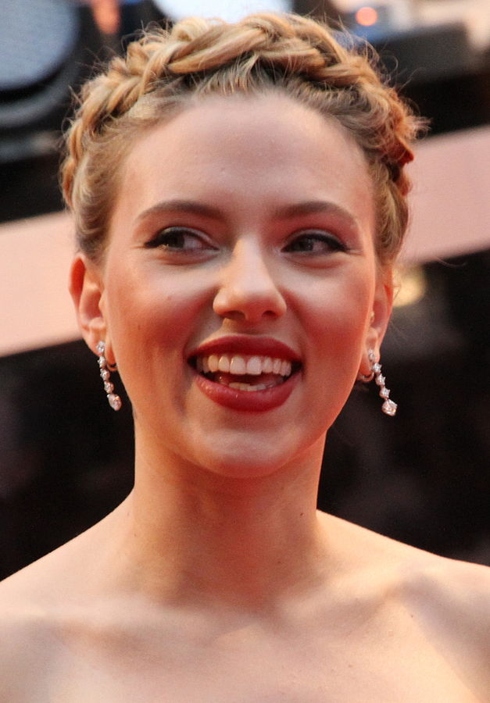
https://en.wikipedia.org/wiki/George_Clooney ; https://commons.wikimedia.org/wiki/File:Scarlett_Johansson_2,_2012.jpg
Notes:
What *is* Scopus?
https://en.wikipedia.org/wiki/George_Clooney
https://commons.wikimedia.org/wiki/File:Scarlett_Johansson_C%C3%A9sars_2014.jpg
https://commons.wikimedia.org/wiki/File:Scarlett_Johansson_2,_2012.jpg
Insert sound clip “I Believe in Miracles”; disco ball;
https://www.youtube.com/watch?v=aOl4oeHZnBk

Slide 15
What is Scopus?
Social and behavioral sciences and other topics outside of clinical health sciences
Similar to Web of Science
Looking at how a scholarly conversation evolved over time
Links to references
Tracking on citations
Analysis of h-index, other numbers
Save Lists, Searches, Alerts (My Scopus)
Export Lists to citation manager

Slide 16
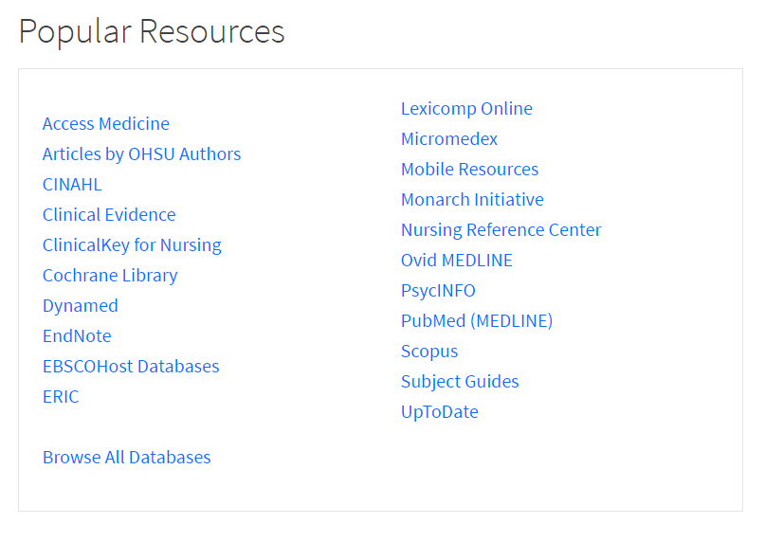

Slide 17
Title and topic searches
Nutrition OR Diet OR Mindfulness
Health outcomes (or mood or attention or stress)
ADD

Slide 18
((("Attention Deficit and Disruptive Behavior Disorders"[Mesh])) AND ((("Diet, Food, and Nutrition"[Mesh])) OR "Mindfulness"[Mesh])) AND ((("Attention"[Mesh]) OR "Stress, Psychological"[Mesh]) OR "Health Status"[Mesh])
51 results
( TITLE-ABS-KEY ( "attention deficit disorder" OR adhd ) AND TITLE-ABS-KEY ( food OR nutrition OR diet OR mindfulness ) AND TITLE-ABS-KEY ( attention OR stress OR "health status" ) )
2,191 results
Notes:
Science example
How do you do a basic search in Scopus? Examples
Keyword, NOT MeSH
Quotation marks for multi-word phrases (“heart attack”)
I like to “OR” within one line and “AND” between lines

Slide 19
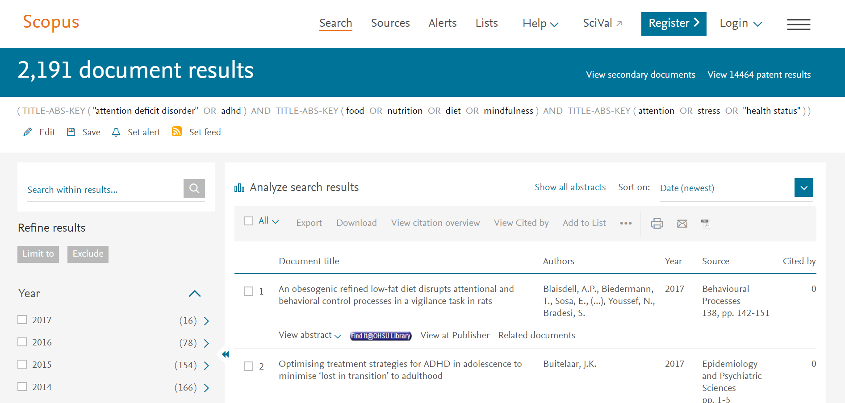
Notes:
Science example here

Slide 20
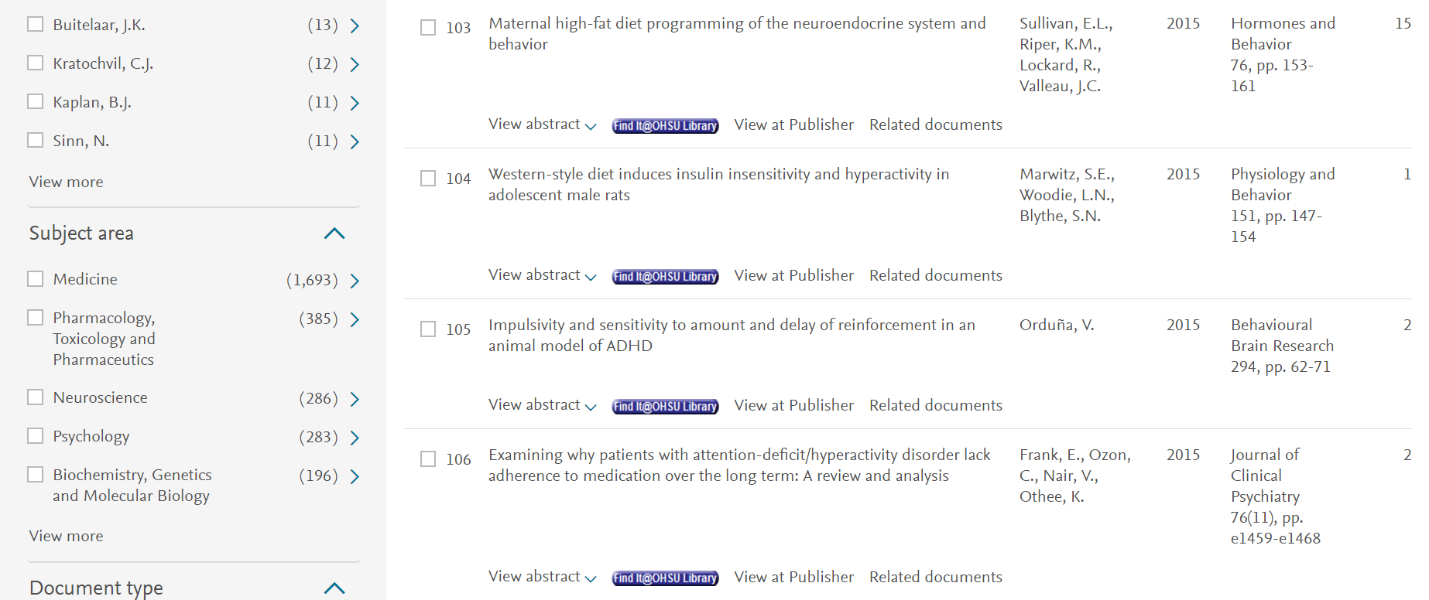

Slide 21
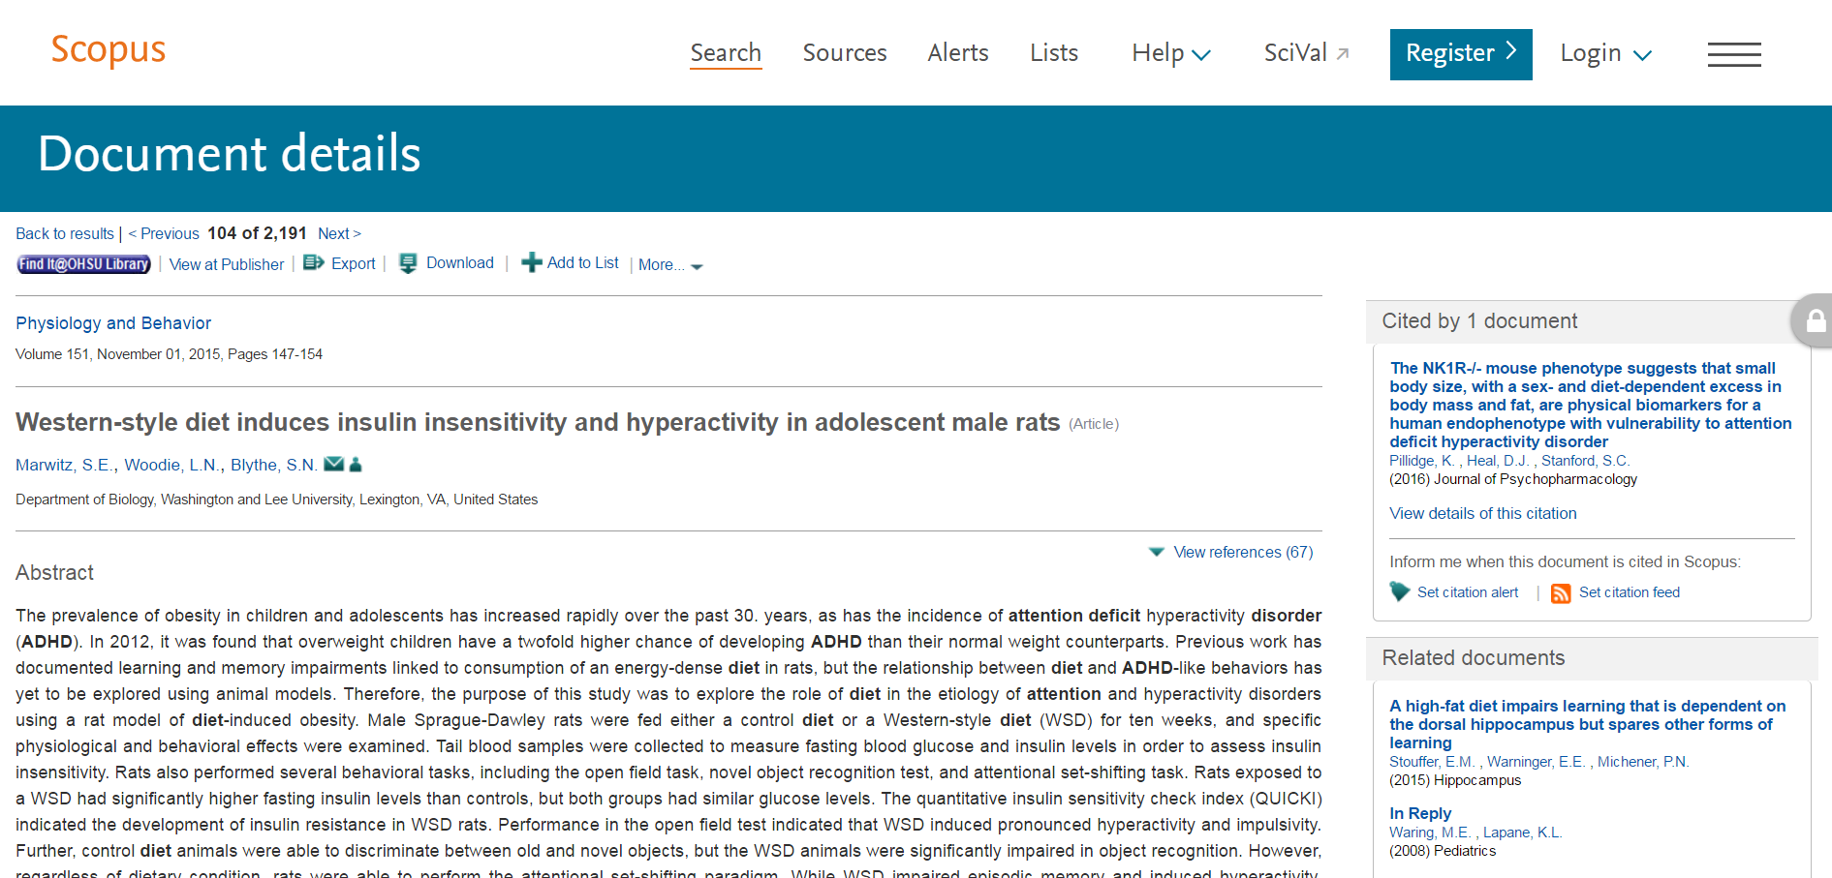

Slide 22
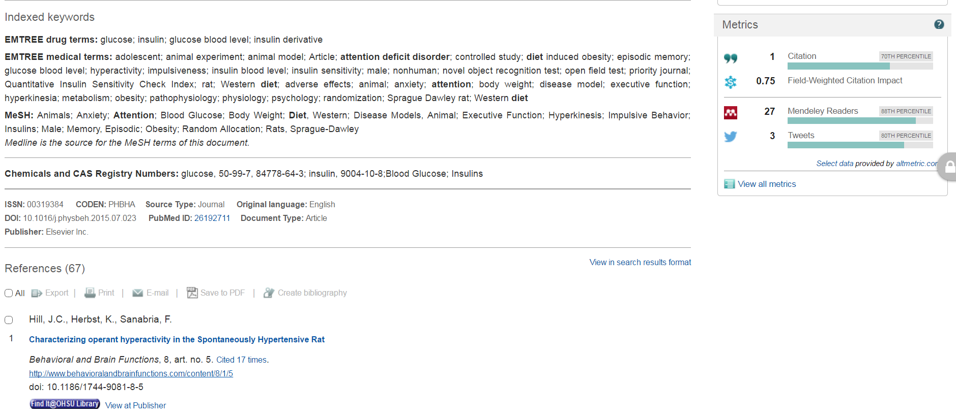

Slide 23
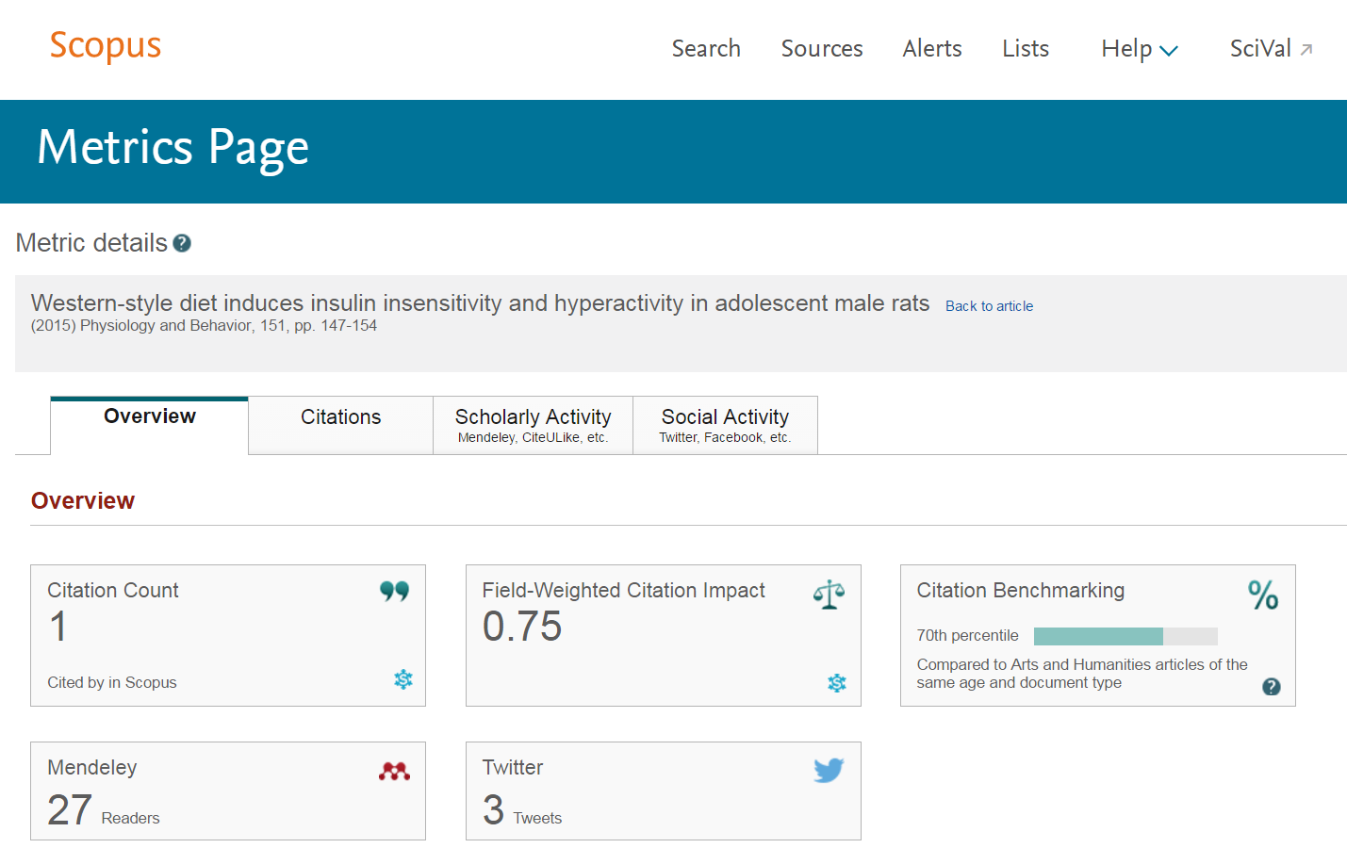

Slide 24
Cited by

Slide 25
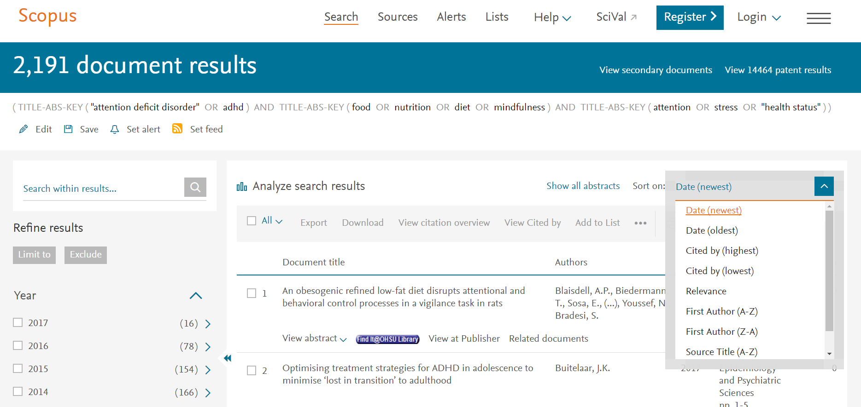
Cited by

Slide 26
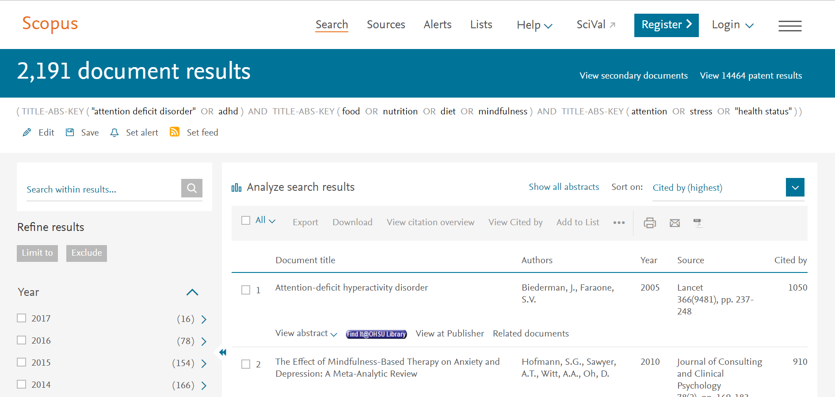
Cited by

Slide 27
Analyzing search results

Slide 28
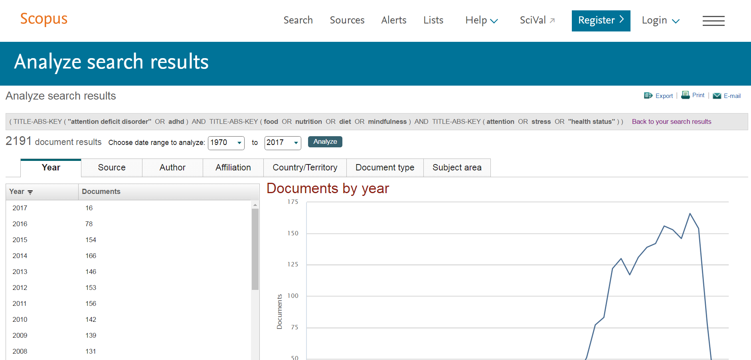
Analyzing search results

Slide 29
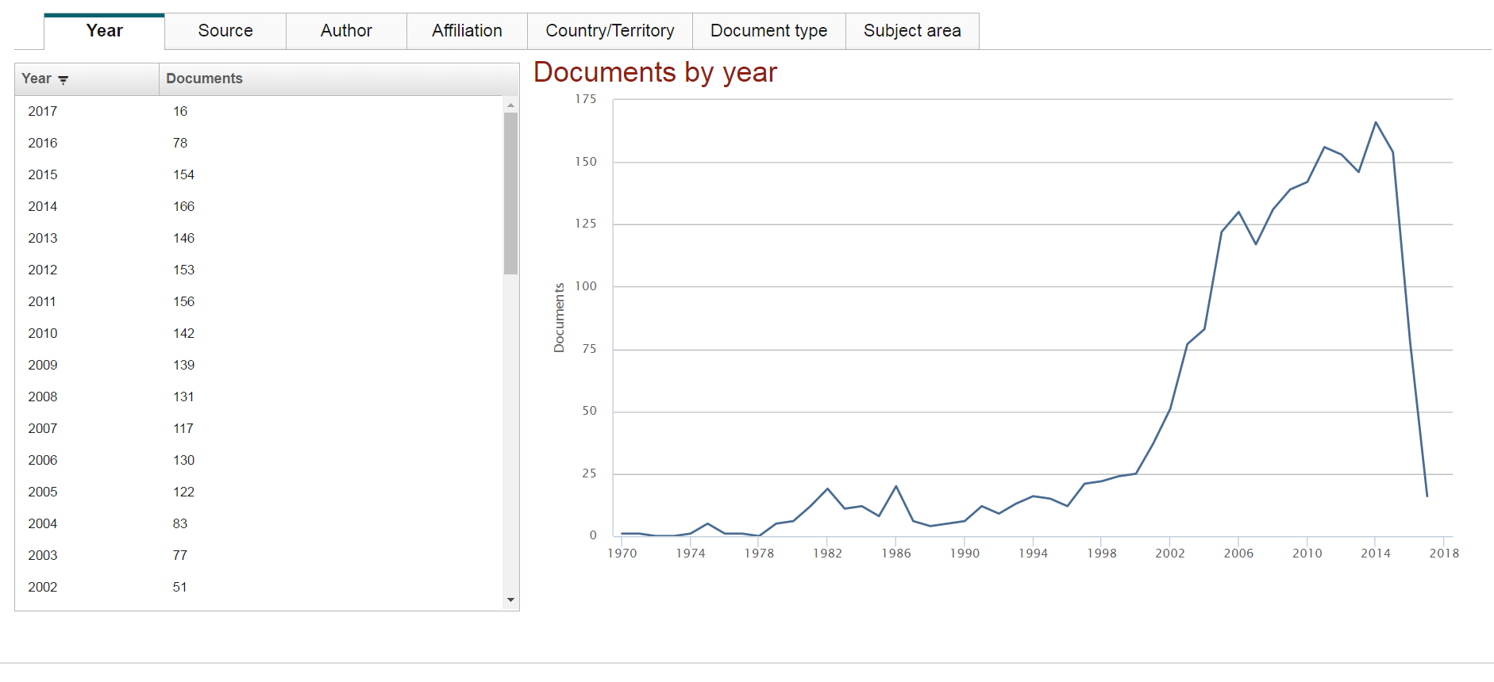
Analyzing search results

Slide 30
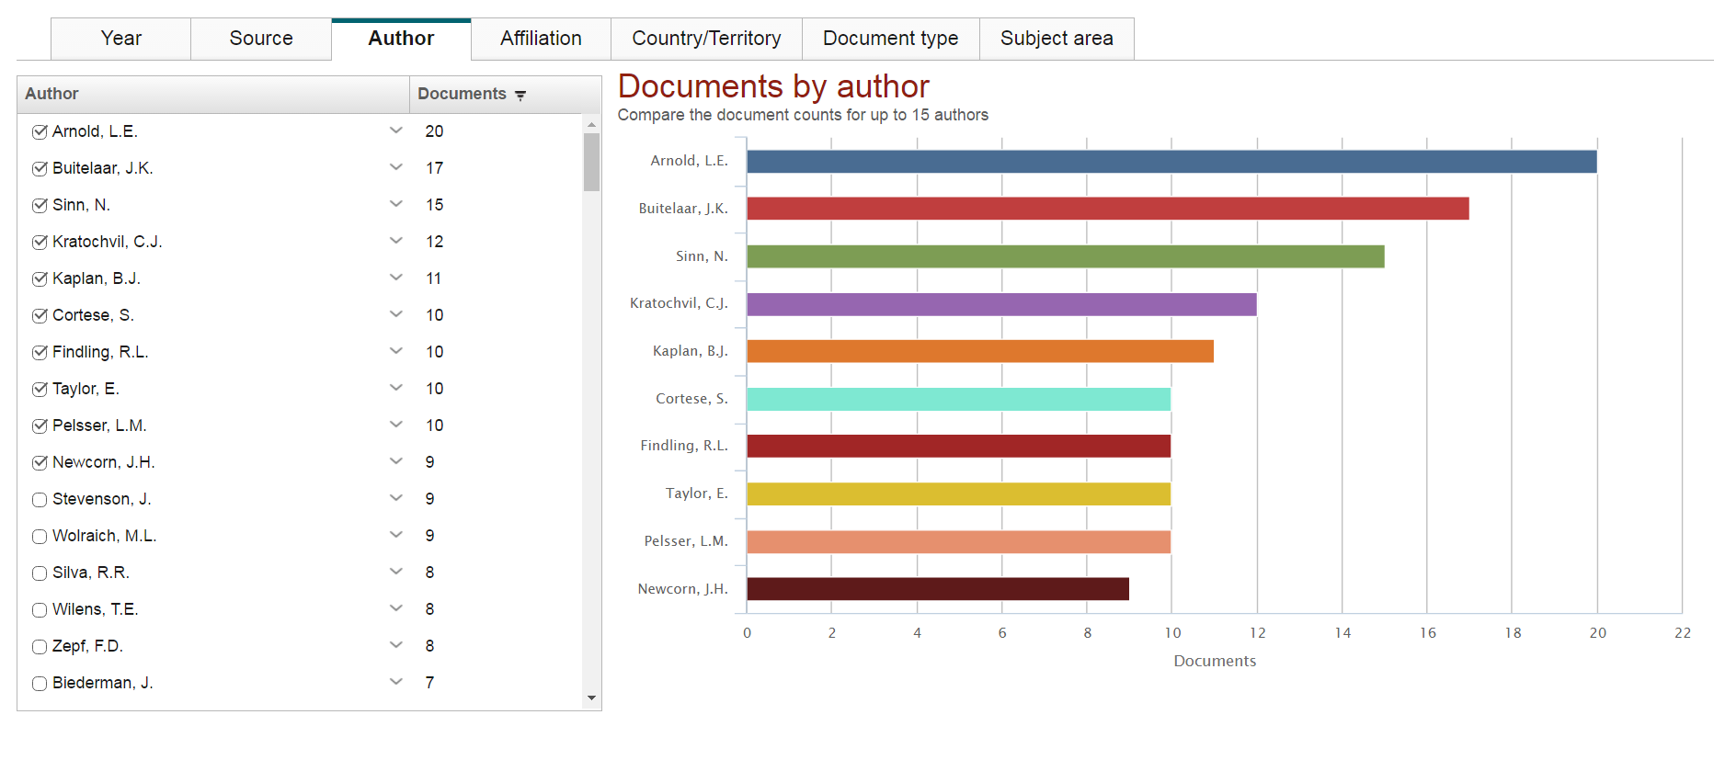
Analyzing search results

Slide 31
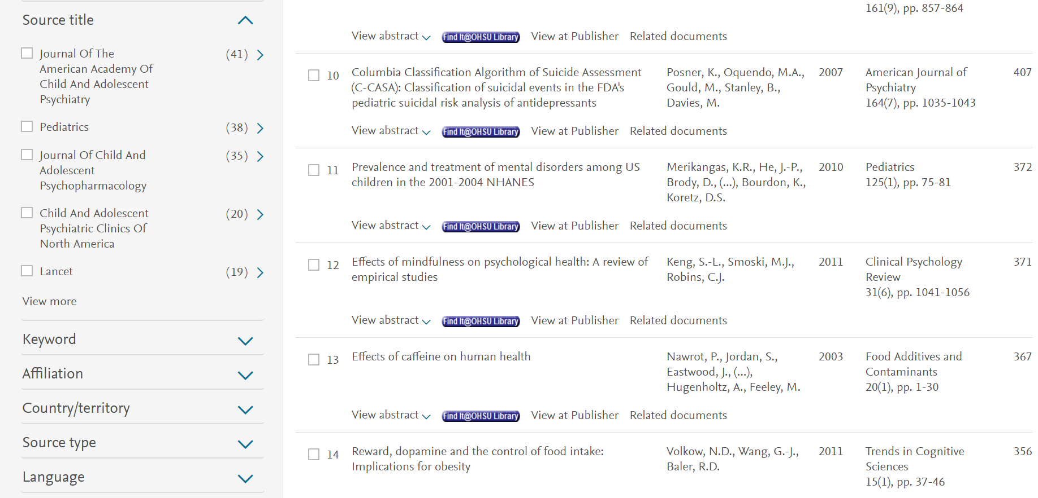
Figuring out which journals are useful
Notes:
CiteScore - Measures average citations received per document published in the serial.
SJR - SCImago Journal Rank measures weighted citations received by the serial. Citation weighting depends on subject field and prestige (SJR) of the citing serial.
SNIP - Source Normalized Impact per Paper measures actual citations received relative to citations expected for the serial’s subject field.

Slide 32
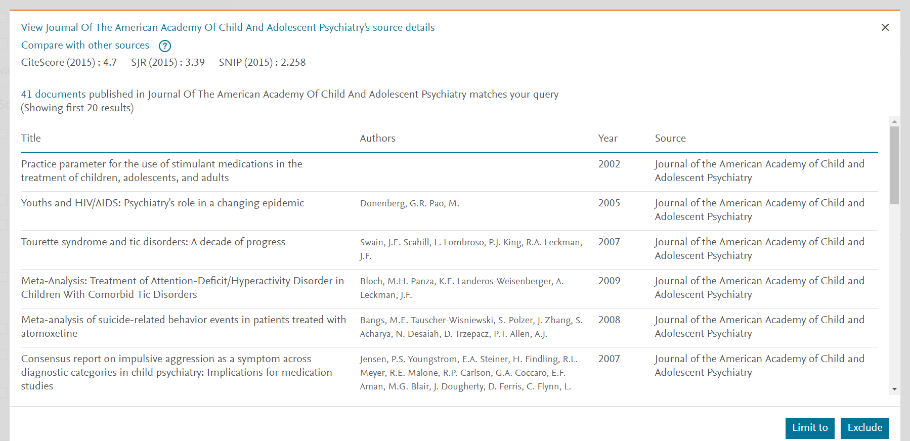
Figuring out which journals are useful
Notes:
CiteScore - Measures average citations received per document published in the serial.
SJR - SCImago Journal Rank measures weighted citations received by the serial. Citation weighting depends on subject field and prestige (SJR) of the citing serial.
SNIP - Source Normalized Impact per Paper measures actual citations received relative to citations expected for the serial’s subject field.

Slide 33
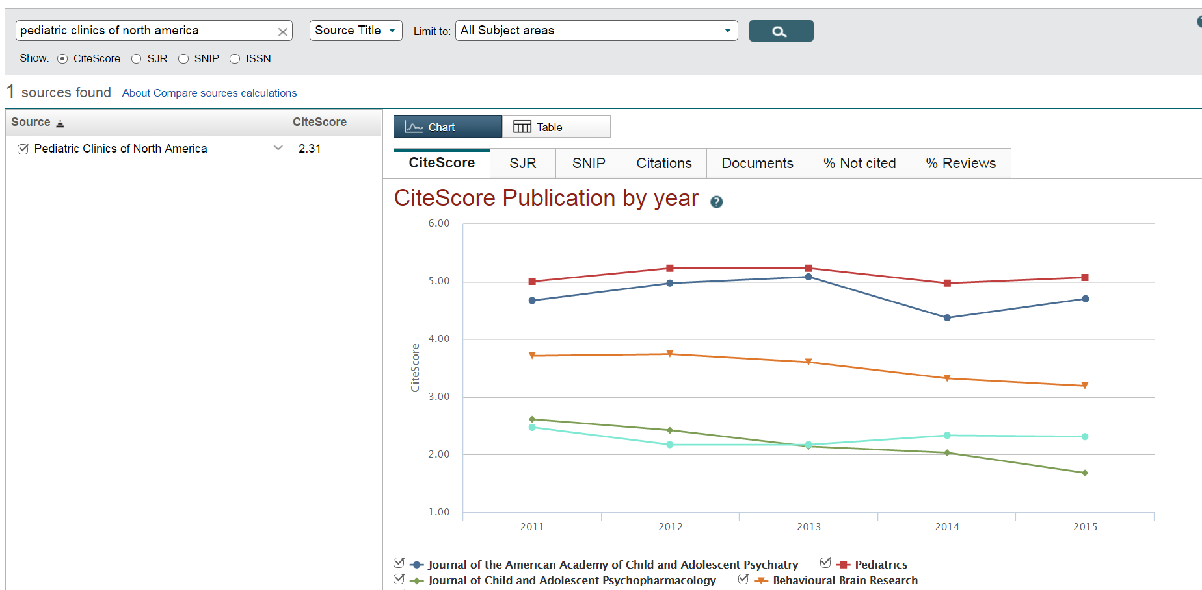
Figuring out which journals are useful
Notes:
CiteScore - Measures average citations received per document published in the serial.
SJR - SCImago Journal Rank measures weighted citations received by the serial. Citation weighting depends on subject field and prestige (SJR) of the citing serial.
SNIP - Source Normalized Impact per Paper measures actual citations received relative to citations expected for the serial’s subject field.

Slide 34
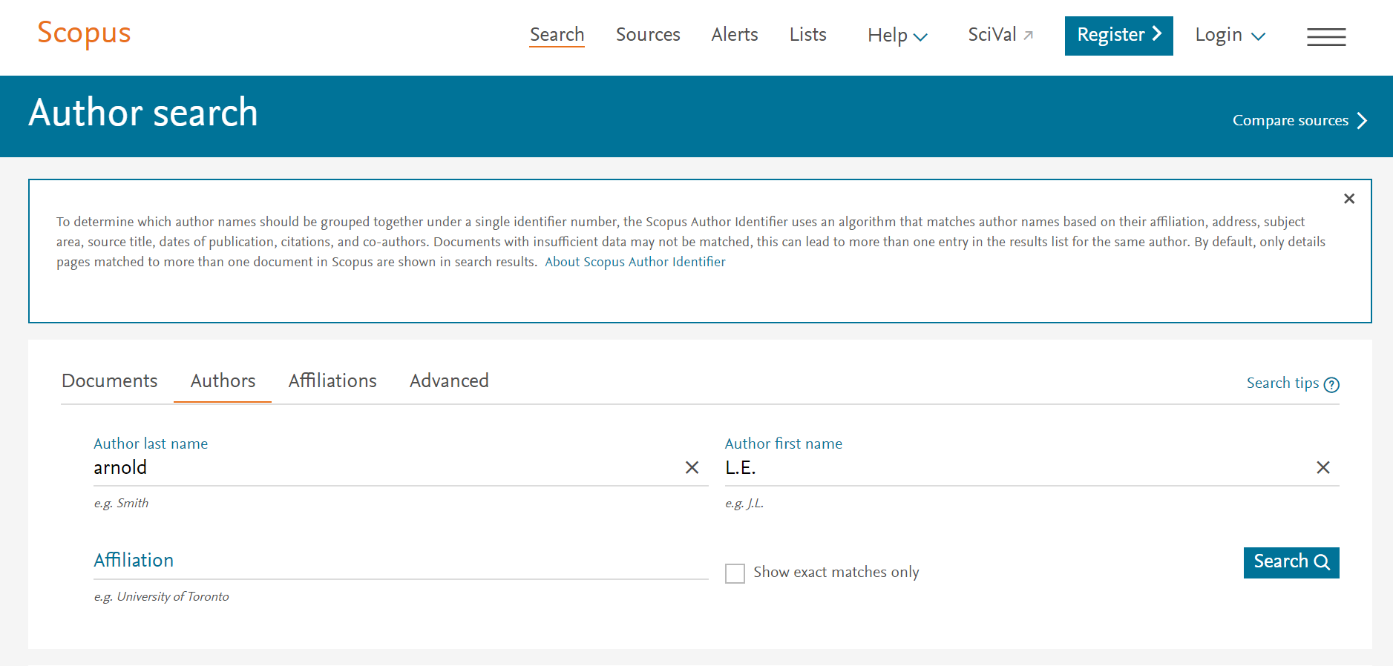
Author search

Slide 35
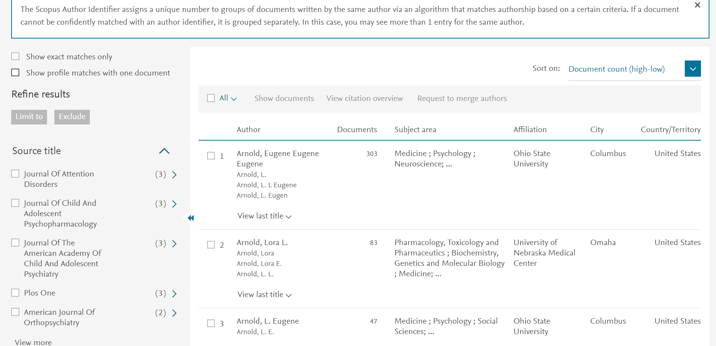
Author search

Slide 36
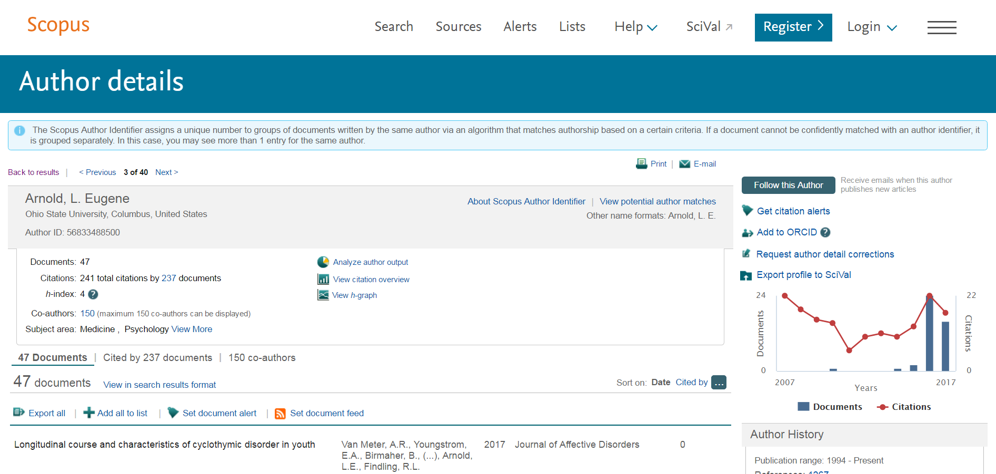
Author search

Slide 37
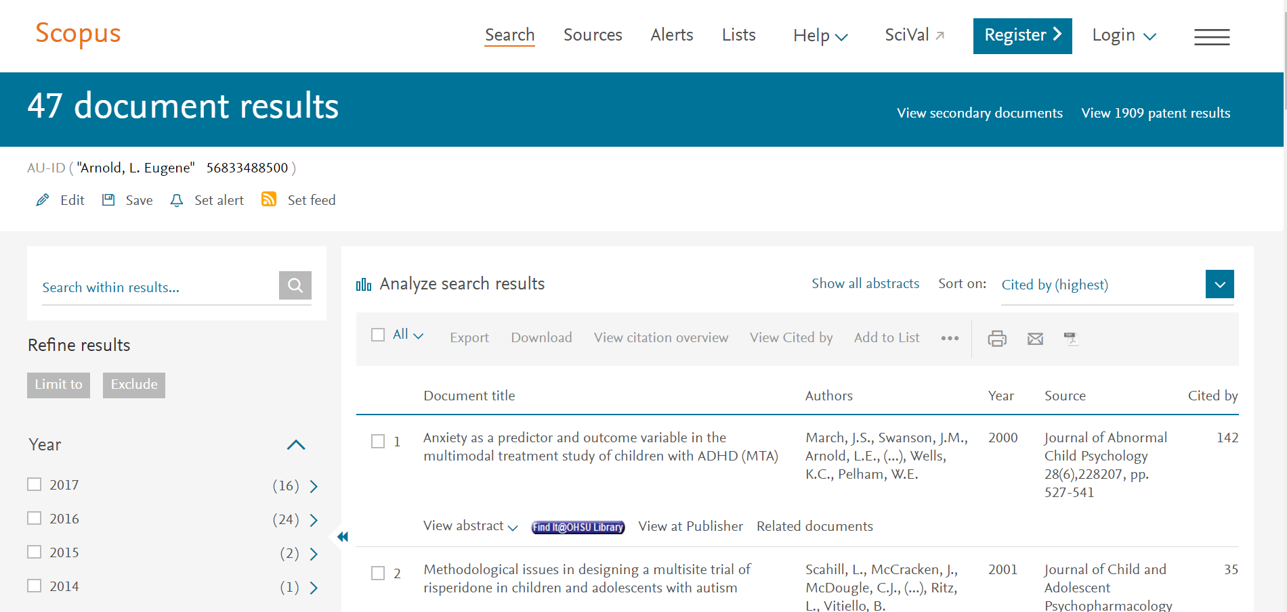
Author search

Slide 38
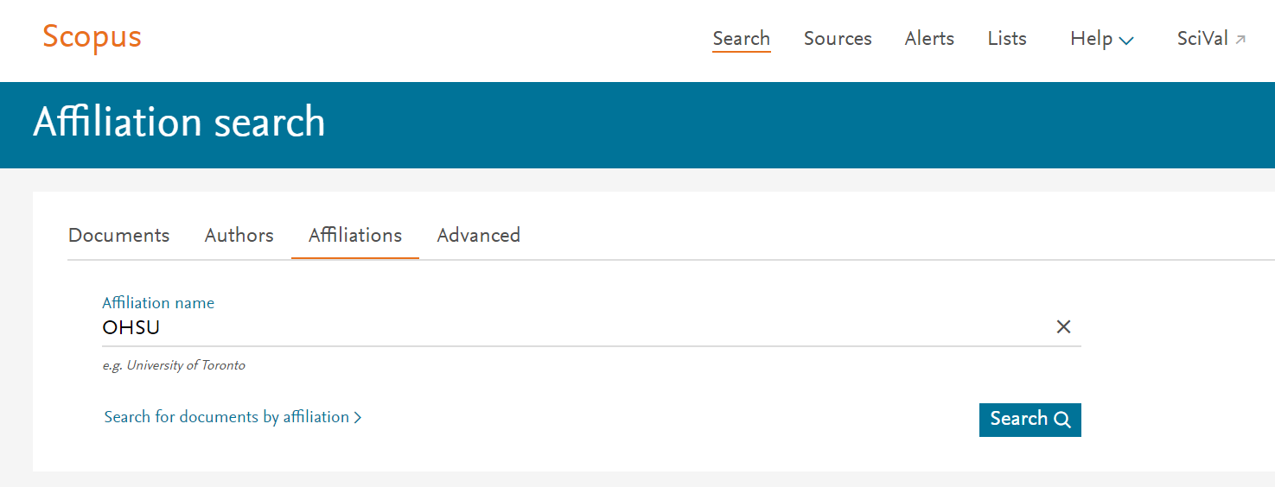
Institution/affiliation search

Slide 39
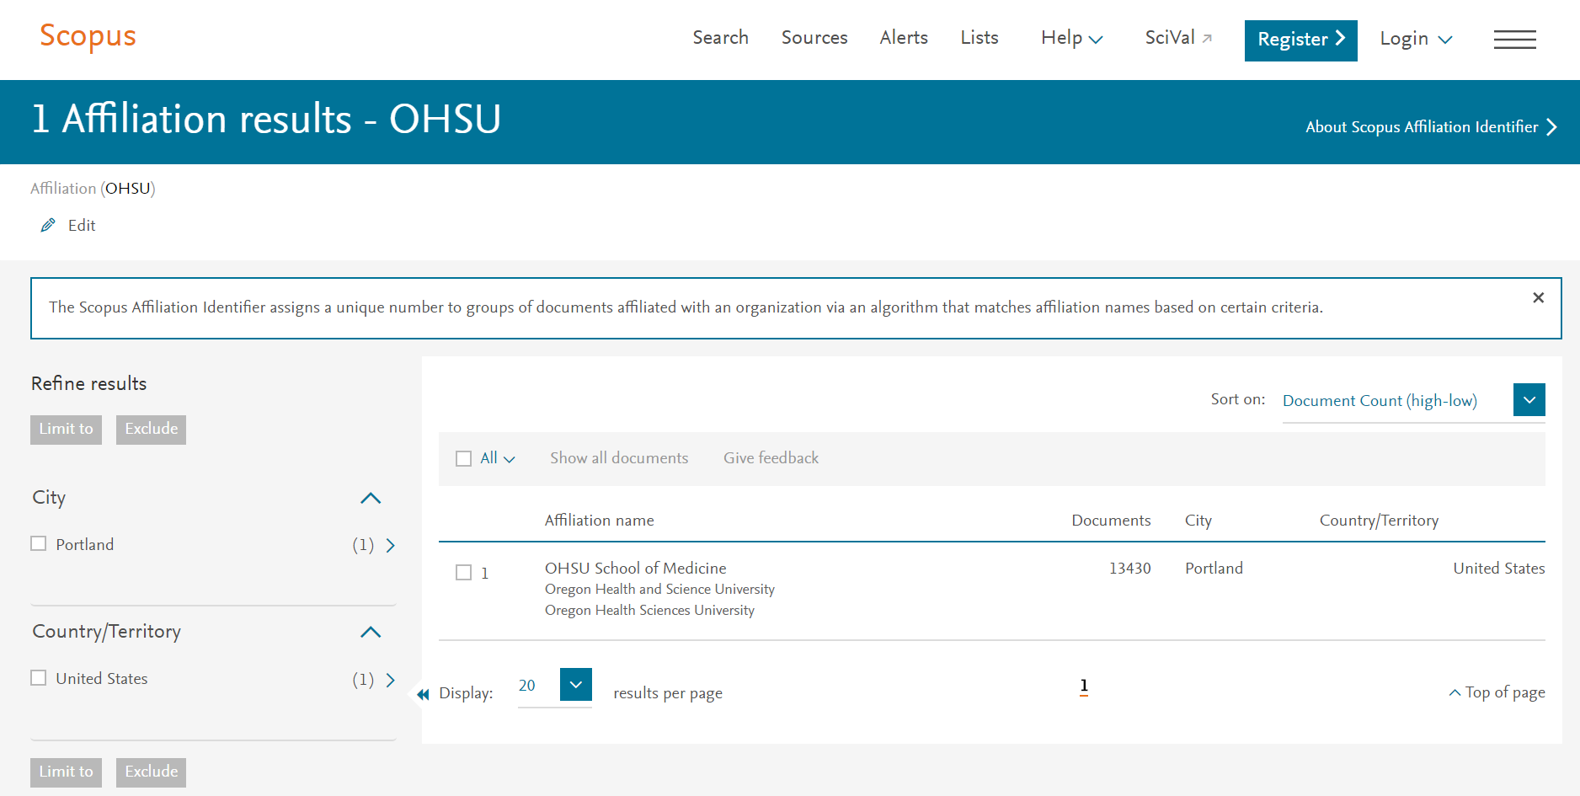
Institution/affiliation search

Slide 40
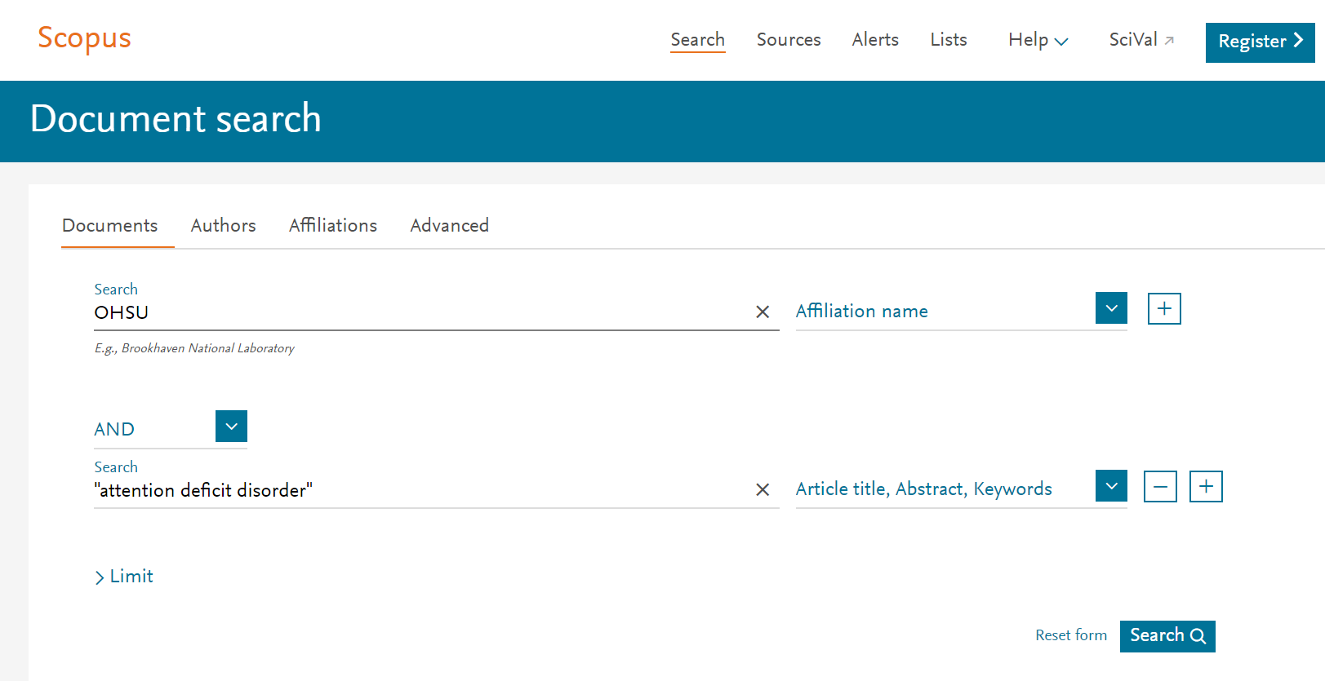
Institution/affiliation search

Slide 41
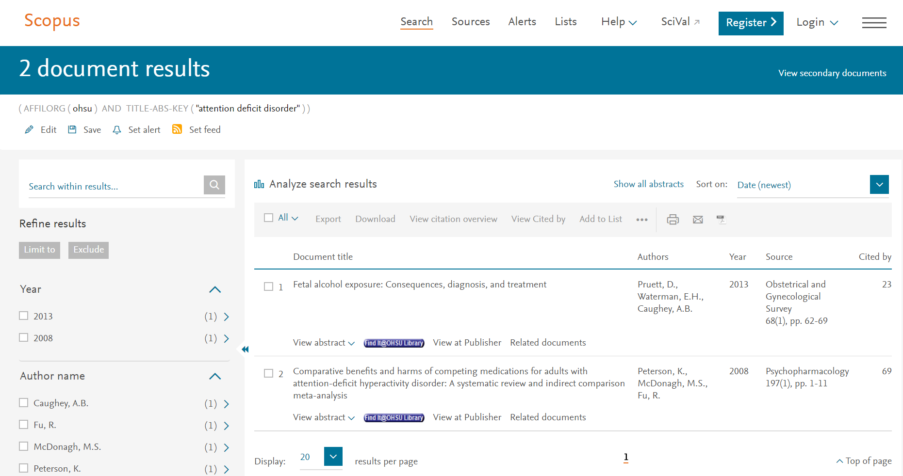
Institution/affiliation search

Slide 42
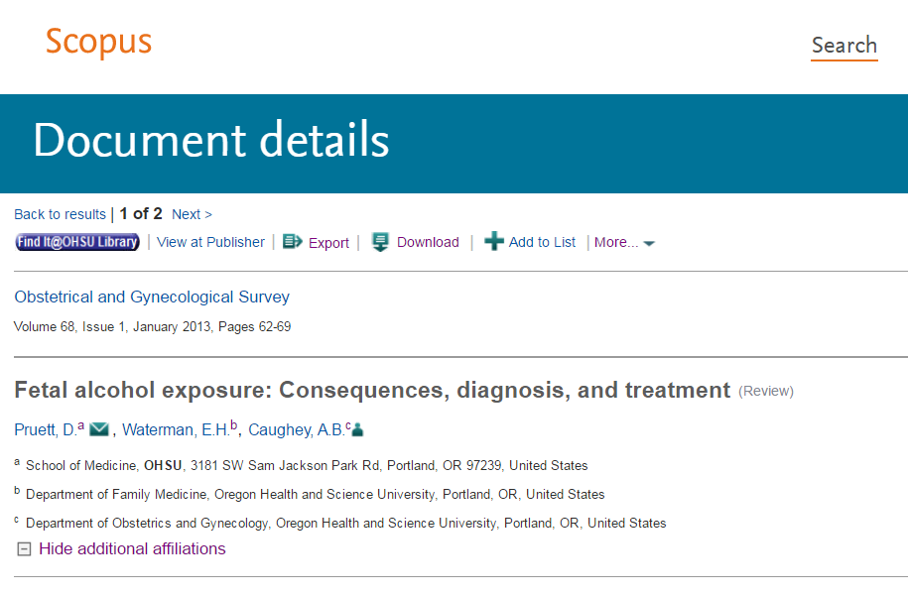
Institution/affiliation search

Slide 43
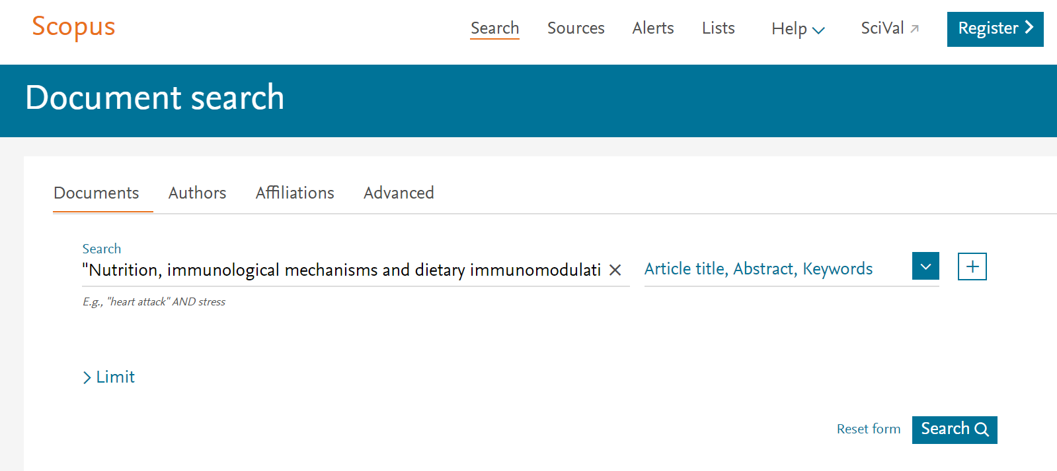
Title search

Slide 44
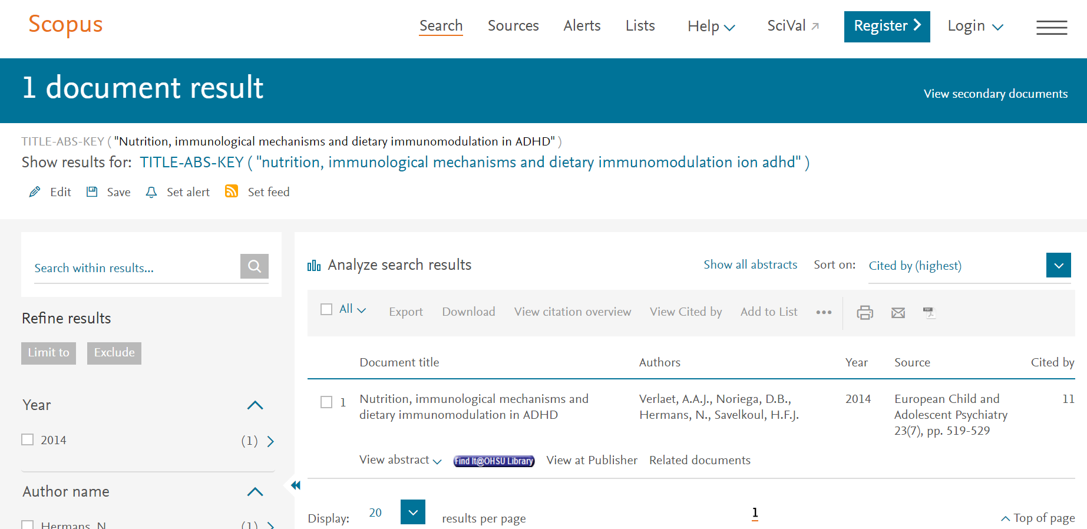
Title search

Slide 45
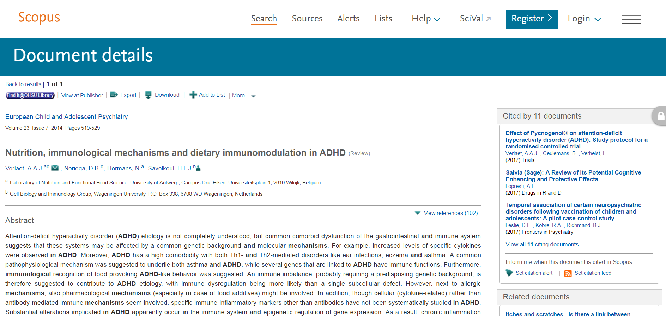
Title search

Slide 46
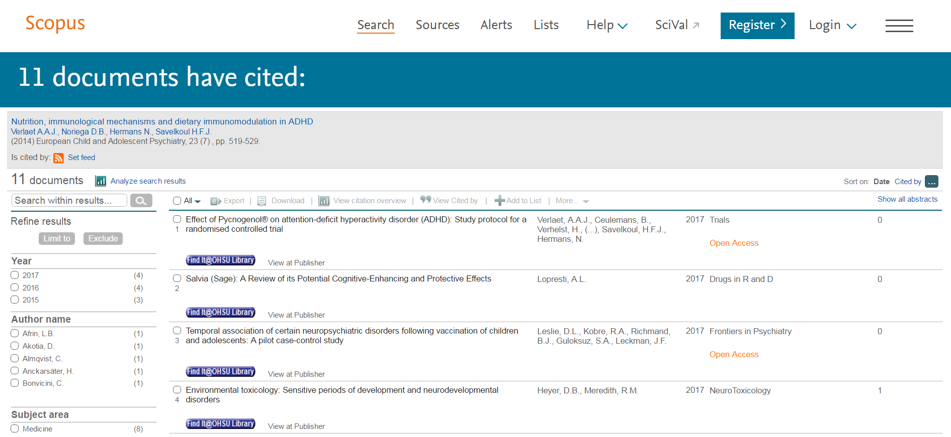
Title search

Slide 47
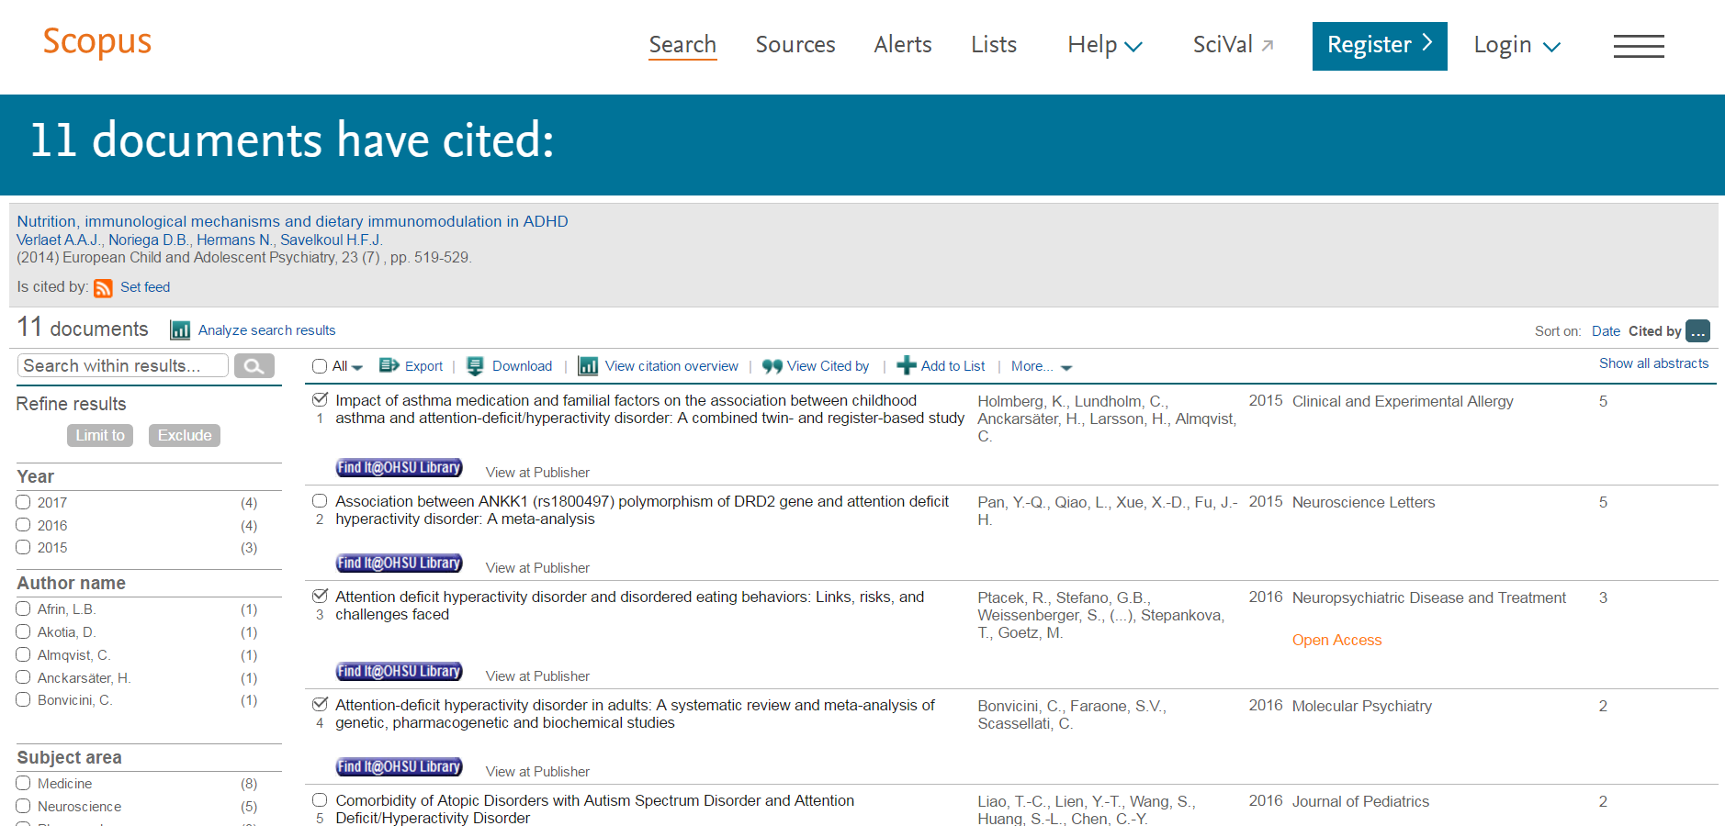
Title search

Slide 48
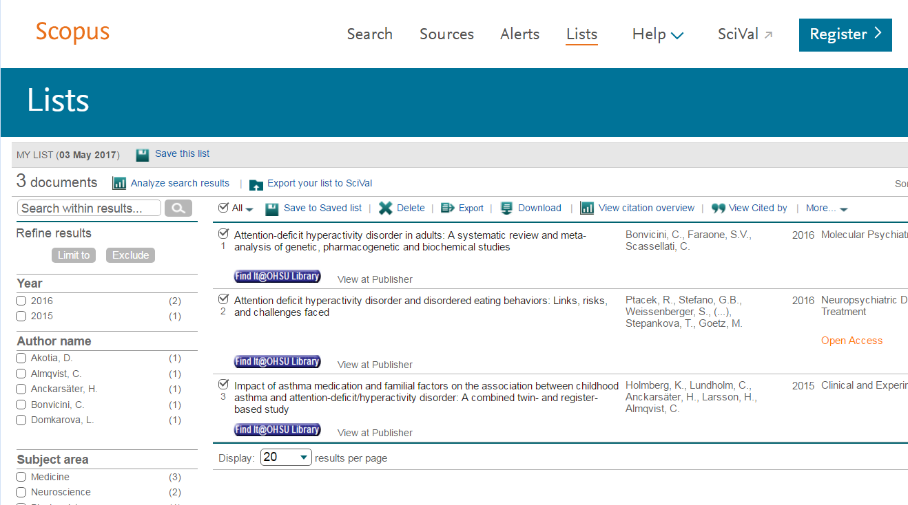
Title search

Slide 49
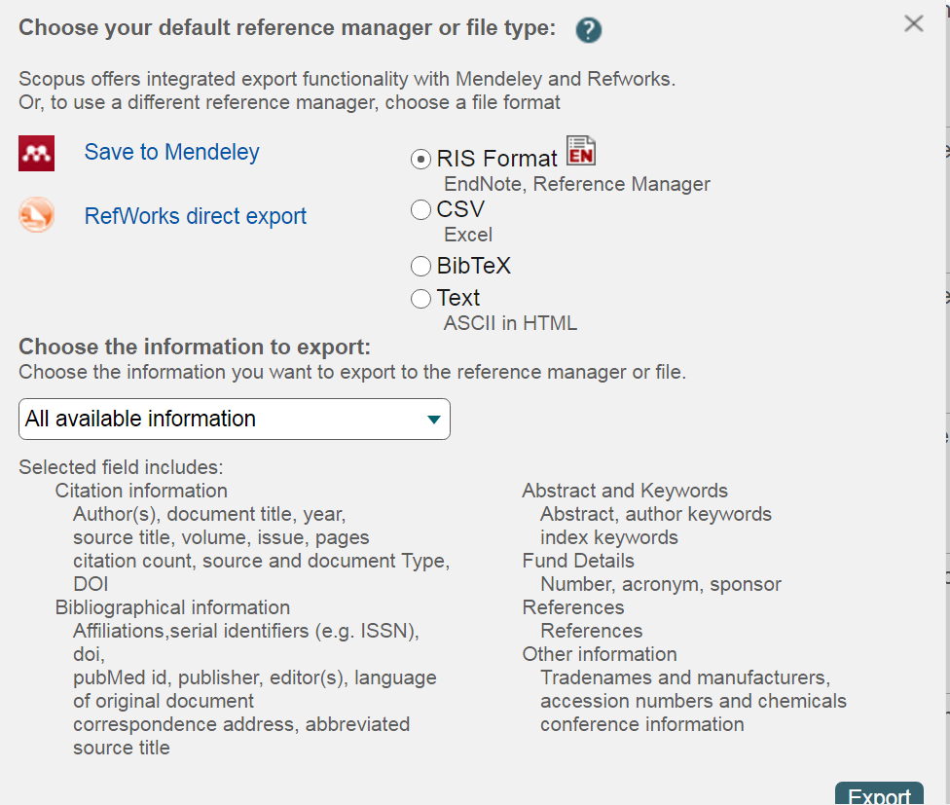
Exporting

Slide 50
Scopus syntax: Controlled vocabulary
No MeSH, so variations are therefore needed
“car accidents” OR “traffic accidents” or “automobile accidents” or “vehicular accidents” in Scopus, versus MeSH term “accidents, traffic”.
Using singular retrieves singular and plural
“car accident*” OR “traffic accident*” or “automobile accident*” or “vehicular accident*”
(car OR traffic OR auto* OR vehic*) W/3 accident*
Notes:
Other particulars of searching in Scopus
Adjacency?
Need to do variations
Asterisk
Other

Slide 51
Scopus syntax: Phrases
Approximate phrases
“heart attack” vs. heart attack
Exact phrases
(heart-attack) is not the same as (heart attack)
(health care?) returns results like: Who pays for health care?
Wildcards (? single character; * one or more)
“diabet*” includes diabetes, diabetic
Notes:
Other particulars of searching in Scopus
Adjacency?
Need to do variations
Asterisk
Other

Slide 52
Scopus syntax: Proximity operators (aka adjacency searching)
Specifies two terms must be within a certain distance of each other.
PRE/n “precedes by”. First term must precede second by a specific number (n) of terms.
W/n “within”. Where terms must be within a specified number of teams. Either term can be first.
Same phrase (3, 4, 5), sentence (15), paragraph (50)
Notes:
Examples:
Pain W/15 morphine
Behavioral PRE/3 disturbances

Slide 53

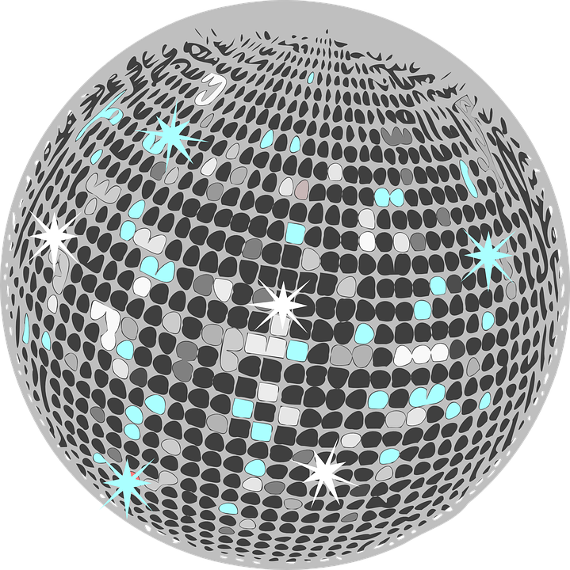
Notes:
https://upload.wikimedia.org/wikipedia/commons/7/77/Heart_symbol_c00.png
https://pixabay.com/p-309645/?no_redirect
Insert sound clip “I Believe in Miracles”; disco ball;
https://www.youtube.com/watch?v=aOl4oeHZnBk

Slide 54
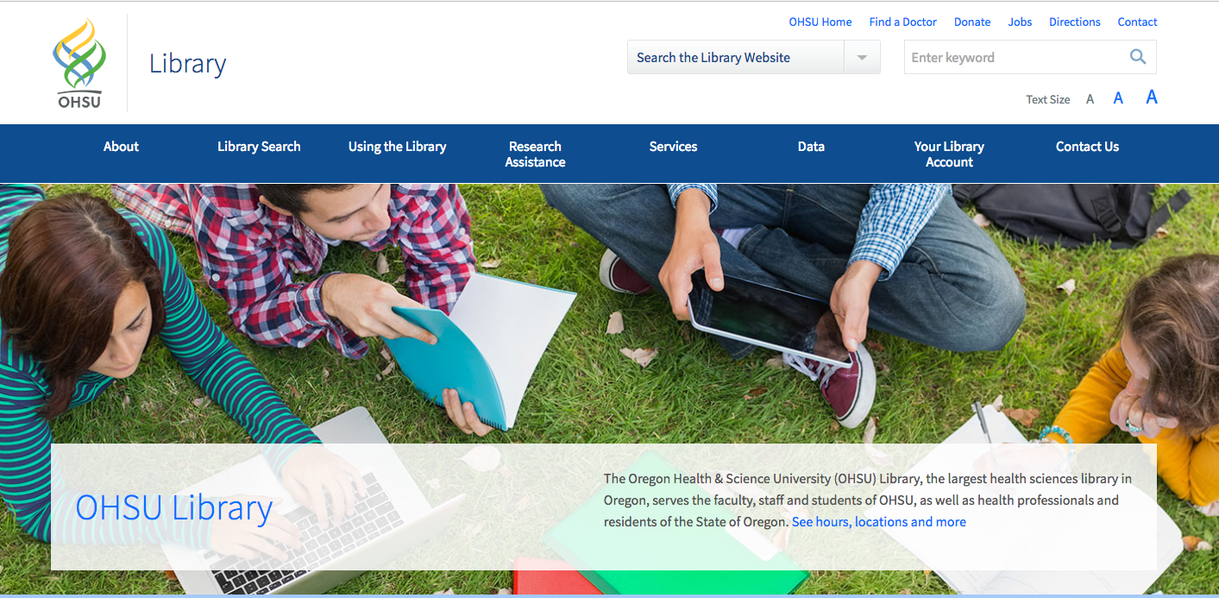
let’s practice together
OHSU Library Webpage
Notes:
Provided example: car accidents and text messaging
Then they use their research question (goal is to acquire some articles or citation files -> we’ll add to citation manager at upcoming session)

Slide 55
recap
1 How to frame your question (define concept
and keywords)
2 Understand the benefit and application of
controlled vocabulary and indexing
3 Execute and save search results or search
strategy

Slide 56
key resources
Ovid Tutorials
Branching Out: The MeSH Vocabulary (11 min video)
Contact us

Slide 57
questions?
Andrew Hamilton, MS, MLS
hamiltoa@ohsu.edu
503.494.7527
Laura Zeigen, MA, MLIS, MPH
zeigenl@ohsu.edu
503.494.0505
Letisha R. Wyatt, PhD
wyattl@ohsu.edu
503.494.8627

